Slide 1
Carbon Compounds
Chapter 2.3

Slide 2
Carbon: The Backbone of Life
Living organisms consist mostly of carbon-based compounds
Carbon is unparalleled in its ability to form large, complex, and varied molecules
Proteins, DNA, carbohydrates, and other molecules that distinguish living matter are all composed of carbon compounds

Slide 3
The electron configuration of carbon gives it covalent compatibility with many different elements
The valences of carbon and its most frequent partners (hydrogen, oxygen, and nitrogen) are the building code for the architecture of living molecules

Slide 4
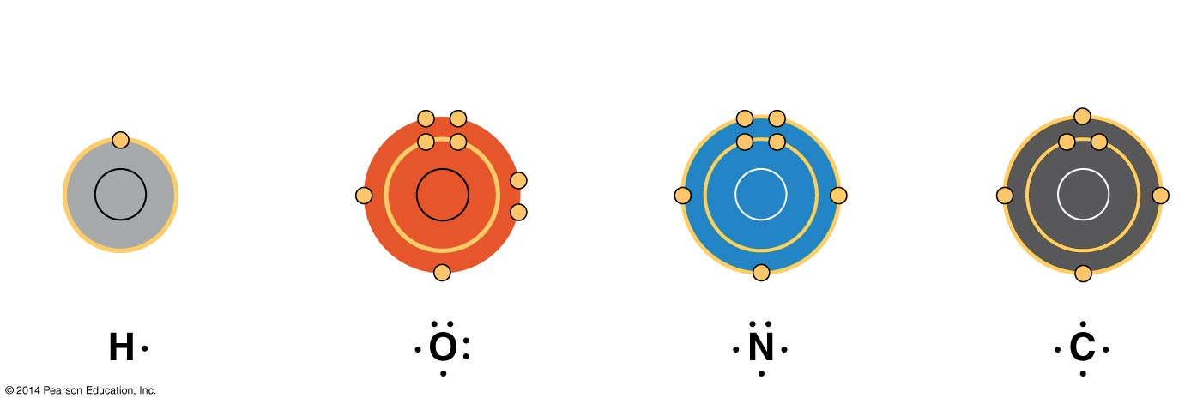
Figure 4.4
Hydrogen
(valence = 1)
Oxygen
(valence = 2)
Nitrogen
(valence = 3)
Carbon
(valence = 4)
Notes:
Figure 4.4 Valences of the major elements of organic molecules

Slide 5
The Molecules of Life
All living things are made up of four classes of large biological molecules: carbohydrates, lipids, proteins, and nucleic acids
Macromolecules are large molecules and are complex
Large biological molecules have unique properties that arise from the orderly arrangement of their atoms

Slide 6
Macromolecules
A polymer is a long molecule consisting of many similar building blocks
The repeating units that serve as building blocks are called monomers
Three of the four classes of life’s organic molecules are polymers
Carbohydrates
Proteins
Nucleic acids

Slide 7
The Synthesis and Breakdown of Polymers
A dehydration reaction occurs when two monomers bond together through the loss of a water molecule
Polymers are disassembled to monomers by hydrolysis, a reaction that is essentially the reverse of the dehydration reaction

Slide 8
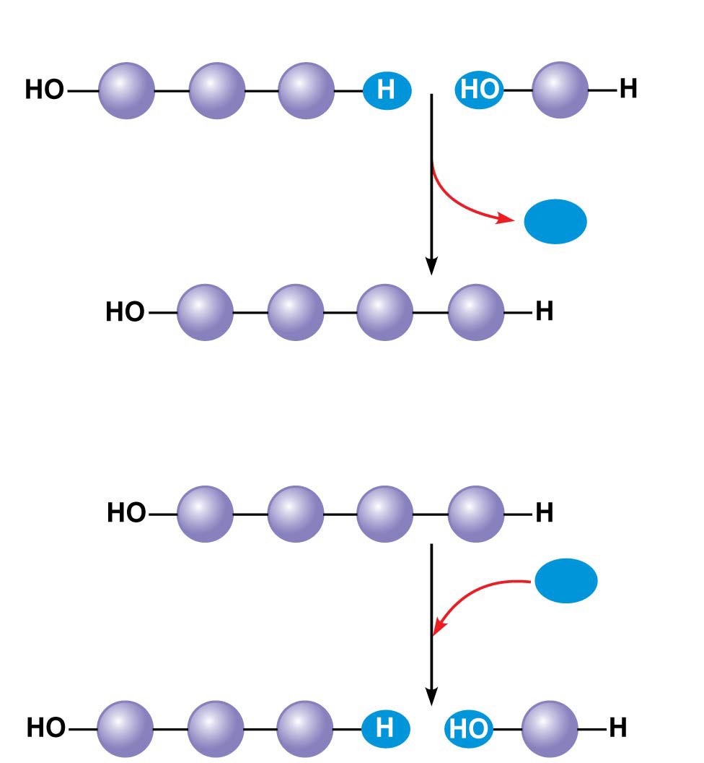
Figure 5.2
(a) Dehydration reaction: synthesizing a polymer
1
2
3
Short polymer
Unlinked monomer
Dehydration removes a water
molecule, forming a new bond.
H₂O
1
2
3
4
Longer polymer
(b) Hydrolysis: breaking down a polymer
1
2
3
4
Hydrolysis adds a water
molecule, breaking a bond.
H₂O
1
2
3
Notes:
Figure 5.2 The synthesis and breakdown of polymers

Slide 9
Carbohydrates
Carbohydrates include sugars and the polymers of sugars
The simplest carbohydrates are monosaccharides, or simple sugars
Carbohydrate macromolecules are polysaccharides, polymers composed of many sugar building blocks
Main source of energy in living things
Plants and animals use carbohydrates for structural purposes

Slide 10
Sugars
Monosaccharides have molecular formulas that are usually multiples of CH₂O
Glucose (C₆H₁₂O₆) is the most common monosaccharide

Slide 11
Monosaccharide
Many of our daily foods include glucose and fructose such as:
Table Sugar
Honey
Disaccharide
Foods containing sucrose, maltose, lactose such as:
Milk
Syrup
Fruits
Polysaccharide
Starches and glycogen
Potatoes
Breads
Rice and
Grains

Slide 12
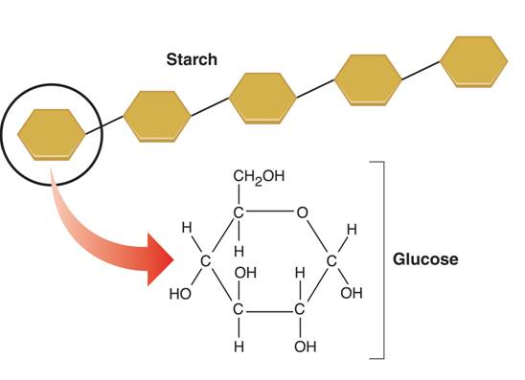
Starch

Slide 13
Lipids
Lipids are the one class of large biological molecules that does not include true polymers
The unifying feature of lipids is that they mix poorly, if at all, with water
Lipids are hydrophobic because they consist mostly of hydrocarbons, which form nonpolar covalent bonds
The most biologically important lipids are fats, phospholipids, and steroids
Energy storage

Slide 14
Lipids
B) Lipids
Large molecules made of mostly carbon and hydrogen that do not form as polymers
Main function is energy storage
Lipids are hydrophobic
Lipids don’t like water because the carbon-hydrogen bonds in lipid molecules are nonpolar
Three groups of lipids are:
1) fats
2) phospholipids
3) steroids

Slide 15
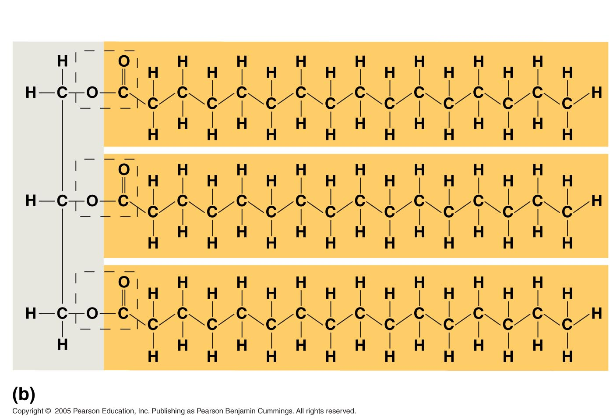
Lipids
Lipids (cont.)
1) Fats
Fats are constructed from fatty acids joined to a glycerol molecule
Fat molecule (triacylglycerol)

Slide 16
Fats
Saturated: Each carbon atom joined to another carbon atom by a single bond.
Unsaturated: If there is at least 1 carbon to carbon double bond. Example: olive oil.
Polyunsaturated: If there is more than one double bond. Examples: corn, sesame, canola, and peanut oil.

Slide 17
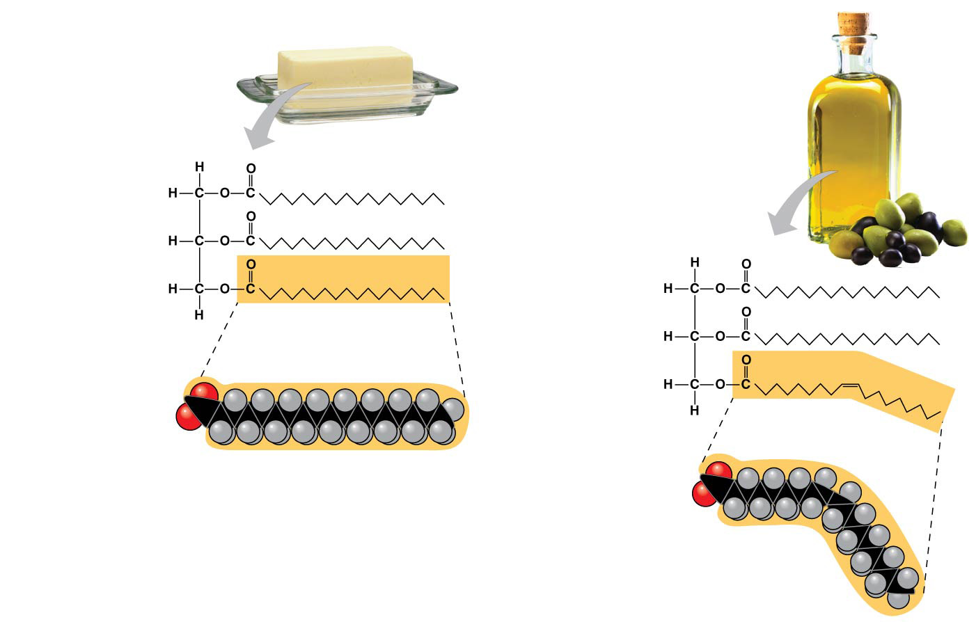
Figure 5.10
(a) Saturated fat
(b) Unsaturated fat
Structural
formula
of a saturated
fat molecule
Structural
formula of an
unsaturated
fat molecule
Space-filling
model of
stearic acid,
a saturated
fatty acid
Space-filling
model of oleic
acid, an
unsaturated
fatty acid
Cis double
bond causes
bending.
Notes:
Figure 5.10 Saturated and unsaturated fats and fatty acids

Slide 18
Lipids
Lipids (cont.)
2) Phospholipids
Phospholipids are made by combining two fatty acids and a phosphate group to a glycerol molecule
Phosphate makes the “head” of the phospholipid hydrophilic
Fatty acids make the “tails” of the phospholipid hydrophobic
Hydrophilic head
Hydrophobic tails

Slide 19
Lipids
B) Lipids (cont.)
2) Phospholipids (cont.)
When put into water, phospholipids arrange themselves into a bilayer
The hydrophilic heads on the water side while the hydrophobic tails are towards each other
Phospholipids are the main component of cell membranes
WATER
Hydrophilic
head
WATER
Hydrophobic
tails

Slide 20
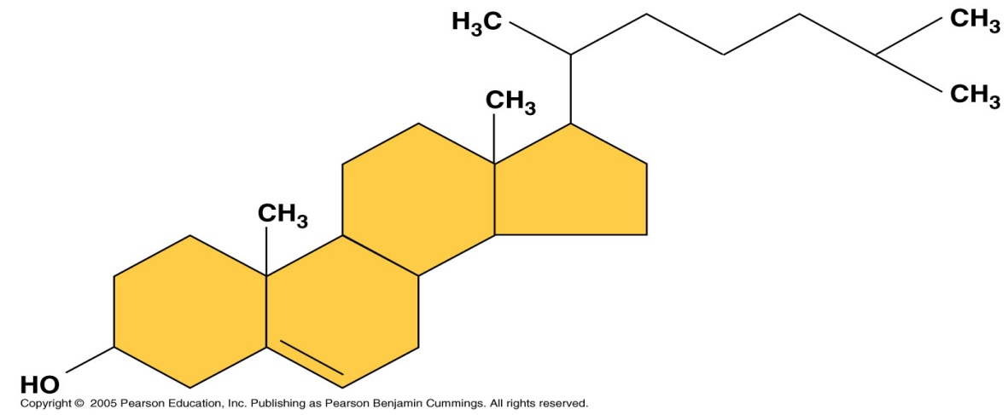
Lipids
B) Lipids (cont.)
3) Steroids
Steroids are lipids that are made from carbon rings
Steroids have important functions in living things
A) Cholesterol: a steroid that helps keep cell membranes in animal cells structurally sound
B) Steroid hormones: steroids that help control biological reactions

Slide 21
Proteins
Proteins account for more than 50% of the dry mass of most cells
Some proteins speed up chemical reactions
Other protein functions include defense, storage, transport, cellular communication, movement, or structural support

Slide 22
Proteins
Functions of proteins
Structural proteins
Form bones and muscles
Transport substances into or out of cells
Functional proteins
Control the rate of reaction
Regulate cell processes
Help fight diseases

Slide 23
Polypeptides (Amino Acid Polymers)
Contain nitrogen, carbon, hydrogen, and oxygen.
Amino acids are linked by covalent bonds called peptide bonds
A polypeptide is a polymer of amino acids
Polypeptides range in length from a few to more than a thousand monomers
Each polypeptide has a unique linear sequence of amino acids, with a carboxyl end (C-terminus) and an amino end (N-terminus)

Slide 24
Proteins

Slide 25
Proteins
4 Levels of Organization
Sequence of amino acids in a polypeptide
Amino acids can be folded or twisted
The chain itself is folded
If there is more than 1 chain, each chain has a specific arrangement

Slide 26
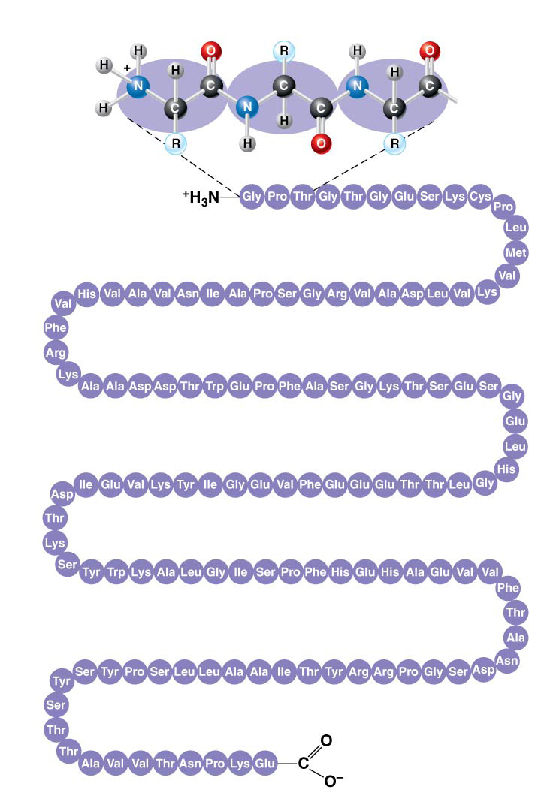
Figure 5.18a
Primary Structure
Amino
acids
1
5
10
Amino end
30
25
20
15
35
40
45
50
Primary structure of transthyretin
70
65
60
55
75
80
85
90
95
115
110
105
100
120
125
Carboxyl end
Notes:
Figure 5.18a Exploring levels of protein structure (part 1: primary)

Slide 27
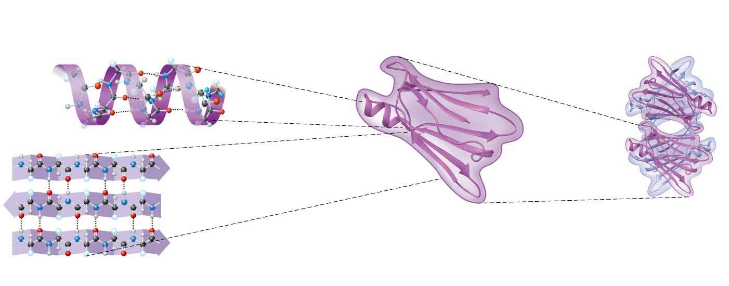
Figure 5.18b
Secondary
Structure
Tertiary
Structure
Quaternary
Structure
𝛂 helix
Hydrogen bond
𝛃 strand
Hydrogen
bond
Transthyretin
polypeptide
Transthyretin
protein
𝛃 pleated sheet
Notes:
Figure 5.18b Exploring levels of protein structure (part 2: secondary through quaternary)

Slide 28
Ch. 5 - Macromolecules
D) Nucleic Acids
Nucleic acids regulate cell functions
There are two types of nucleic acids
1) DNA = Deoxyribonucleic acid
2) RNA = Ribonucleic acid

Slide 29
The Roles of Nucleic Acids
There are two types of nucleic acids
Deoxyribonucleic acid (DNA)
Ribonucleic acid (RNA)
DNA provides directions for its own replication
DNA directs synthesis of messenger RNA (mRNA) and, through mRNA, controls protein synthesis
This process is called gene expression

Slide 30
Ch. 5 – Macromolecules
D) Nucleic Acids (cont.)
Nucleic acids are polymers made from monomers called nucleotides
All nucleotides contain:
1) Sugar
2) Phosphate group
3) Nitrogenous base
A, C, G, T, or U
Nitrogenous
base
Phosphate
group
Pentose
sugar
Nucleotide
Nucleotide

Slide 31
The Components of Nucleic Acids
Nucleic acids are polymers called polynucleotides
Each polynucleotide is made of monomers called nucleotides
Each nucleotide consists of a nitrogenous base, a pentose sugar, and one or more phosphate groups
The portion of a nucleotide without the phosphate group is called a nucleoside

Slide 32
Section 2-3
Carbon
Compounds
include
Carbohydrates
Lipids
Nucleic acids
Proteins
that consist of
that consist of
that consist of
that consist of
Sugars and
starches
Fats and oils
Nucleotides
Amino Acids
which contain
which contain
which contain
which contain
Carbon,
hydrogen,
oxygen
Carbon,
hydrogen,
oxygen
Carbon,hydrogen,
oxygen, nitrogen,
phosphorus
Carbon,
hydrogen,oxygen,
nitrogen,

